Slide 1
Midterm I

Slide 2
What are the three perspectives of NLP

Slide 3
What are the three perspectives of NLP
Engineering : Use CL as part of a larger application. Emphasis on Robustness (doesn’t collapse on unexpected input); Coverage (does something useful with most inputs) and Efficiency (return an answer in a timely manner).
Cognitive Science: gain an understanding of how people comprehend and produce language.
Theoretical Linguistics: test the empirical adequacy of theoretical models (e.g. POS tagging algorithm).

Slide 4

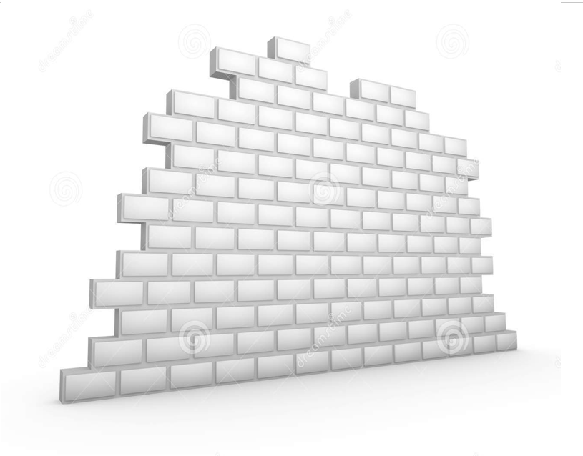



What was Turing’s proposed solution to determine if a computer is intelligent

Slide 5
Name and Describe one of the Objections Turing discussed in his paper

Slide 6
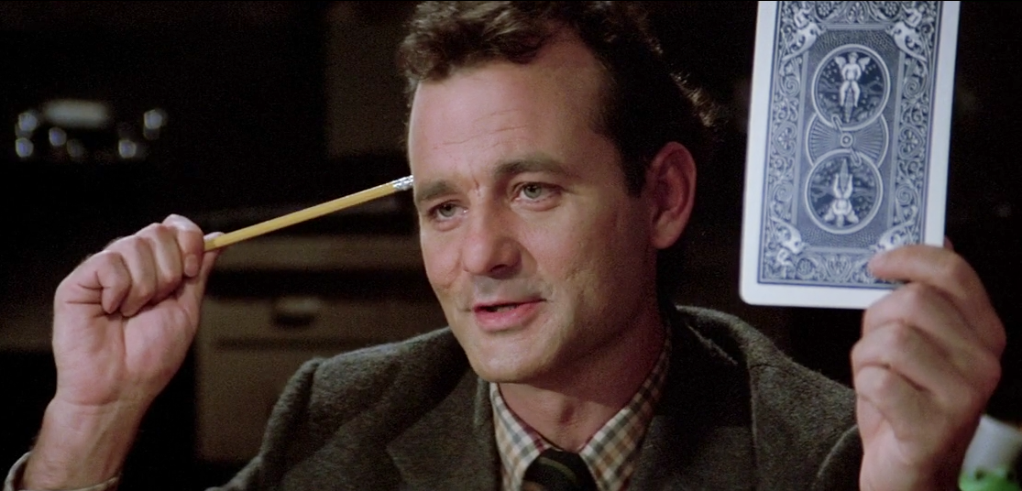
Name and Describe one of the Objections Turing discussed in his paper

Slide 7
What was Searle’s Chinese Room Argument?

Slide 8
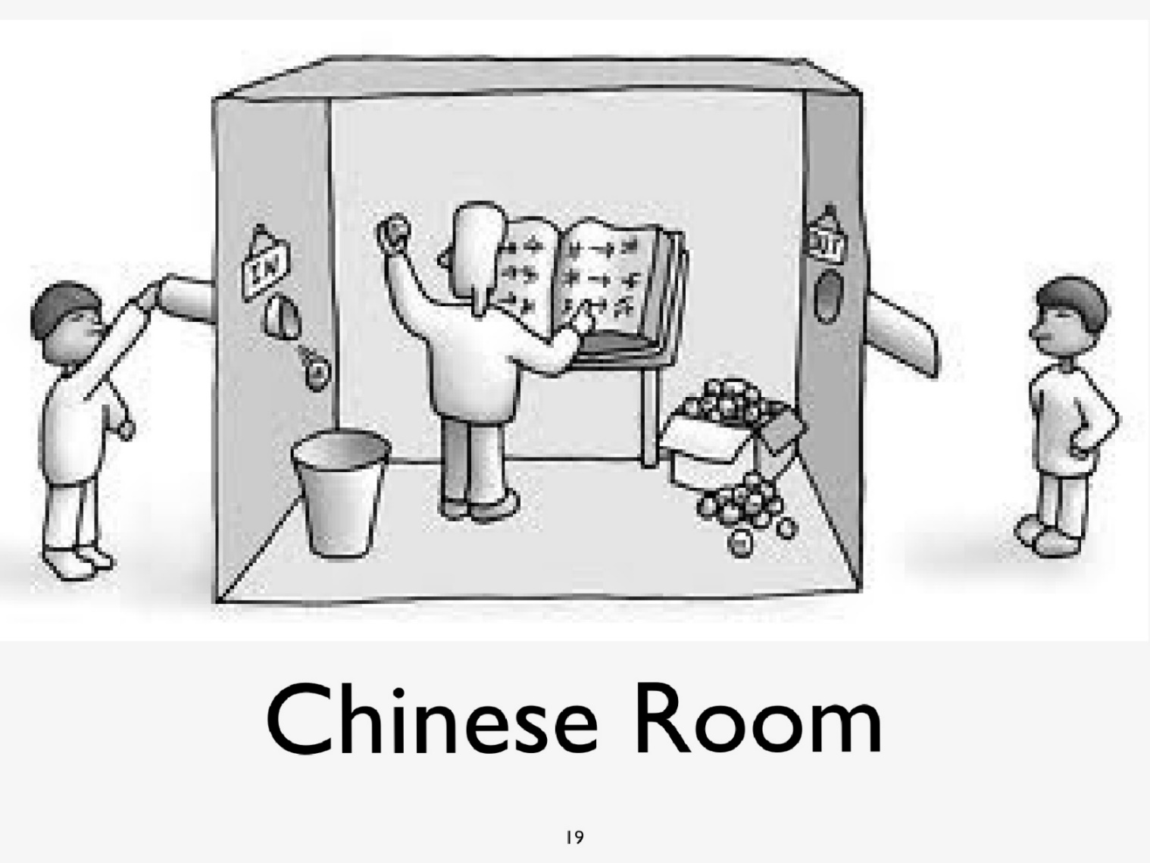
What was Searle’s Chinese Room Argument?

Slide 9
Who is Eliza?

Slide 10
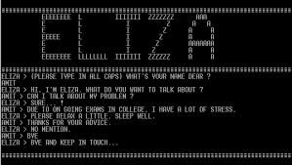
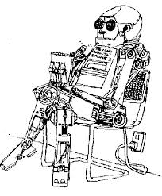
Who is Eliza?
1966: Joseph Weizenbaum developed Eliza a Rogerian psychotherapist

Slide 11
What is a companionable agent

Slide 12
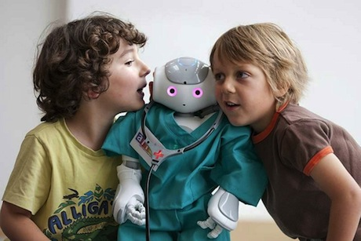
What is a companionable agent
Companionable agents are artificial agents devised to accompany users day by day building long-term relationships with them.

Slide 13
Write a regex to identify duplicate words in text

Slide 14
Write a regex to identify duplicate words in text
/\b(\w)\b\1\b/
# the extra \\ is delimiting the \ in the string
my $regex = "\\b(\\w)\\b\\1\\b"; # /\b(\w)\b\1\b/
my $yes = "very very nice";
my $not = "this is nice";
if($yes=~/(\w+) \1/) {
print "yes gotit\n";
}
if($not=~/$regex/) {
print "not didn't gotit\n";
}

Slide 15
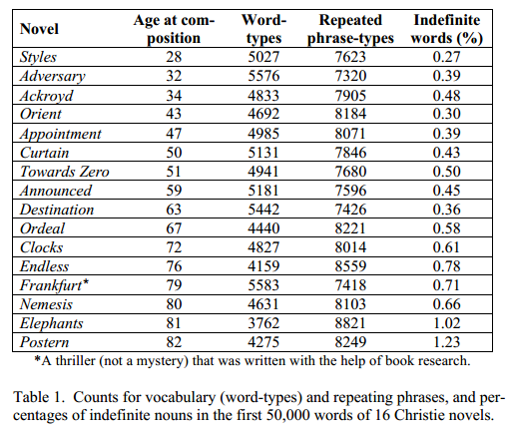
State and describe one of the metrics used to analyze Agatha Christie’s writing

Slide 16
What NLP application uses ngrams

Slide 17
What NLP application uses ngrams
Spelling Correction
Collocation identification
Topic identificaiton

Slide 18
How does the NLP application use ngrams?

Slide 19
What is the Chain Rule?

Slide 20
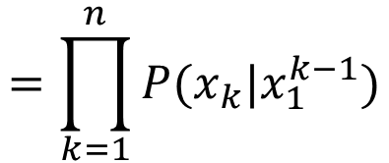
What is the Chain Rule?
The chain rule allows us to decompose the probability into a product of component conditional probabilities

Slide 21
Why would use the chain rule?

Slide 22
What is the Markov Assumption?

Slide 23
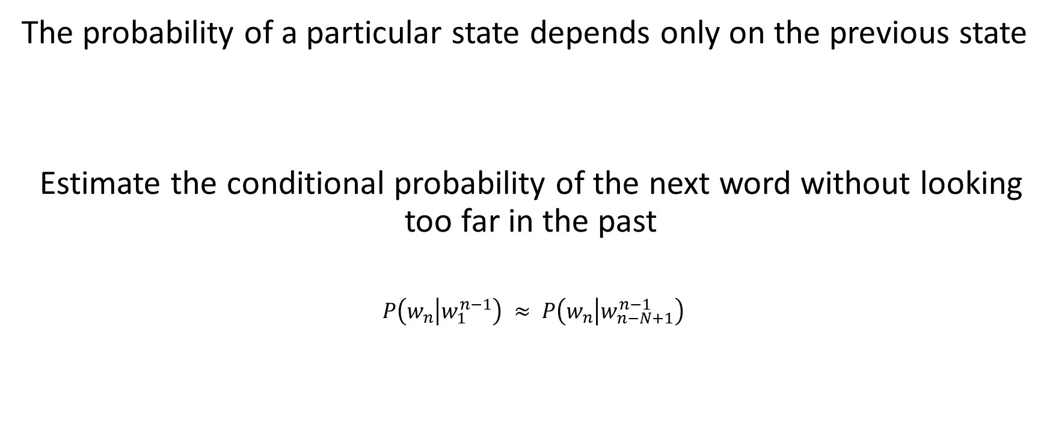
What is the Markov Assumption?
The probability of a particular state depends only on the previous state
Estimate the conditional probability of the next word without looking too far in the past
$P\left(w_{n} | w_{1}^{n−1}\right) ≈ P\left(w_{n} | w_{n−N+1}^{n−1}\right)$

Slide 24
Why would we use the Markov Assumption?

Slide 25
Given the trigram assumption, what is the equation for calculating the probability of the sentence:
I knew who I was this morning but I have changed a few times since then

Slide 26
Given the trigram assumption, what is the equation for calculating the probability of the sentence:
I knew who I was this morning but I have changed a few times since then
P(I) *
P(knew | I) *
P(who | I knew) *
P(was | knew who) *
P(this | who was) *
…
P(then |times since)

Slide 27
Can you do this for any ngram?

Slide 28

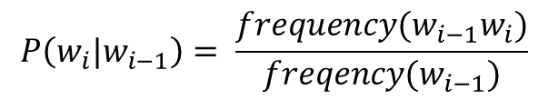
What is the probability of speaks given she
$$P\left(w_{i}|w_{i−1}\right)= \frac{frequency(w_{i−1}w_{i})}{freqency(w_{i−1})}$$
 | <start> | she | speaks | french | often | <end>
<start> | 0 | 2125 | 250 | 25 | 100 | 0
she | 0 | 0 | 2800 | 400 | 400 | 0.36
speaks | 0 | 0 | 0 | 1700 | 200 | 80
French | 0 | 0 | 0 | 0 | 400 | 50
often | 0 | 200 | 300 | 100 | 0 | 300
<end> | 0 | 0 | 0 | 0 | 0 | 0
$$P\left(w2|w1\right)= \frac{frequency(w1 w2)}{frequency(w1)}$$
she | speaks | French | often | <start> | <end>
4000 | 2000 | 500 | 1000 | 2500 | 2500

Slide 29
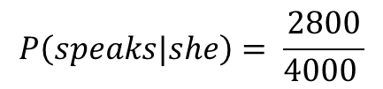
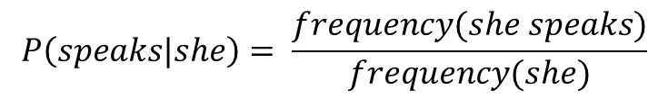
What is the probability of speaks given she
$$P\left(w_{i}|w_{i−1}\right)= \frac{frequency(w_{i−1}w_{i})}{freqency(w_{i−1})}$$
 | <start> | she | speaks | french | often | <end>
<start> | 0 | 2125 | 250 | 25 | 100 | 0
she | 0 | 0 | 2800 | 400 | 400 | 0.36
speaks | 0 | 0 | 0 | 1700 | 200 | 80
French | 0 | 0 | 0 | 0 | 400 | 50
often | 0 | 200 | 300 | 100 | 0 | 300
<end> | 0 | 0 | 0 | 0 | 0 | 0
$$P\left(w2|w1\right)= \frac{frequency(w1 w2)}{frequency(w1)}$$
$$P\left(speaks|she\right)= \frac{frequency(she speaks)}{frequency(she)}$$
she | speaks | French | often | <start> | <end>
4000 | 2000 | 500 | 1000 | 2500 | 2500
$$P\left(speaks|she\right)= \frac{2800}{4000 }$$

Slide 30
Using add-one smoothing, what is the probability of she speaks?
 | <start> | she | speaks | french | often | <end>
<start> | 0 | 2125 | 250 | 25 | 100 | 0
she | 0 | 0 | 2800 | 400 | 400 | 0.36
speaks | 0 | 0 | 0 | 1700 | 200 | 80
French | 0 | 0 | 0 | 0 | 400 | 50
often | 0 | 200 | 300 | 100 | 0 | 300
<end> | 0 | 0 | 0 | 0 | 0 | 0
she | speaks | French | often | <start> | <end>
4000 | 2000 | 500 | 1000 | 2500 | 2500

Slide 31
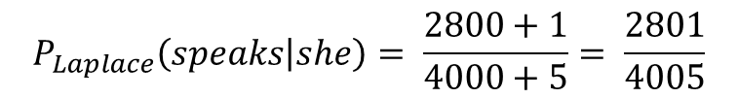
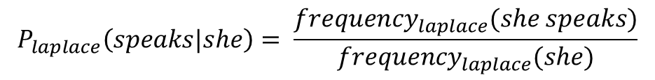
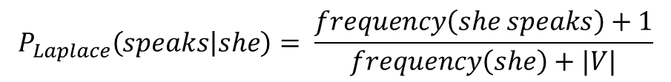
Using add-one smoothing, what is the probability of she speaks?
$$P_{laplace}\left(speaks|she\right)= \frac{{frequency}_{laplace}(she speaks)}{{frequency}_{laplace}(she)}$$
 | <start> | she | speaks | french | often | <end>
<start> | 0 | 2125 | 250 | 25 | 100 | 0
she | 0 | 0 | 2800 | 400 | 400 | 0.36
speaks | 0 | 0 | 0 | 1700 | 200 | 80
French | 0 | 0 | 0 | 0 | 400 | 50
often | 0 | 200 | 300 | 100 | 0 | 300
<end> | 0 | 0 | 0 | 0 | 0 | 0
$$P_{Laplace}\left(speaks | she\right)= \frac{frequency\left(she speaks\right)+1}{frequency\left(she\right)+|V|}$$
$$P_{Laplace}\left(speaks | she\right)= \frac{2800+1}{4000+5}= \frac{2801}{4005}$$
she | speaks | French | often | <start> | <end>
4000 | 2000 | 500 | 1000 | 2500 | 2500

Slide 32
Using add-one smoothing, what is the probability of she speaks?
$$P_{laplace}\left(speaks|she\right)= \frac{{frequency}_{laplace}(she speaks)}{{frequency}_{laplace}(she)}$$
 | <start> | she | speaks | french | often | <end>
<start> | 0 | 2125 | 250 | 25 | 100 | 0
she | 0 | 0 | 2800 | 400 | 400 | 0.36
speaks | 0 | 0 | 0 | 1700 | 200 | 80
French | 0 | 0 | 0 | 0 | 400 | 50
often | 0 | 200 | 300 | 100 | 0 | 300
<end> | 0 | 0 | 0 | 0 | 0 | 0
$$P_{Laplace}\left(speaks | she\right)= \frac{frequency\left(she speaks\right)+1}{frequency\left(she\right)+|V|}$$
$$P_{Laplace}\left(speaks | she\right)= \frac{2800+1}{4000+5}= \frac{2801}{4005}$$
she | speaks | French | often | <start> | <end>
4000 | 2000 | 500 | 1000 | 2500 | 2500

Slide 33
What is the difference between continguous and non-contiguous ngrams?

Slide 34
When would non-contiguous ngrams be useful?

Slide 35
What is a stoplist and why would you use one?

Slide 36
Now why would you not use one?

Slide 37
What are association measures?

Slide 38
What are association measures?
Basic idea:
ratio between
how often we saw something occur and
how often we expect it to occur based on random

Slide 39
How did Turney use association measures to determine whether a review was positive or negative?

Slide 40
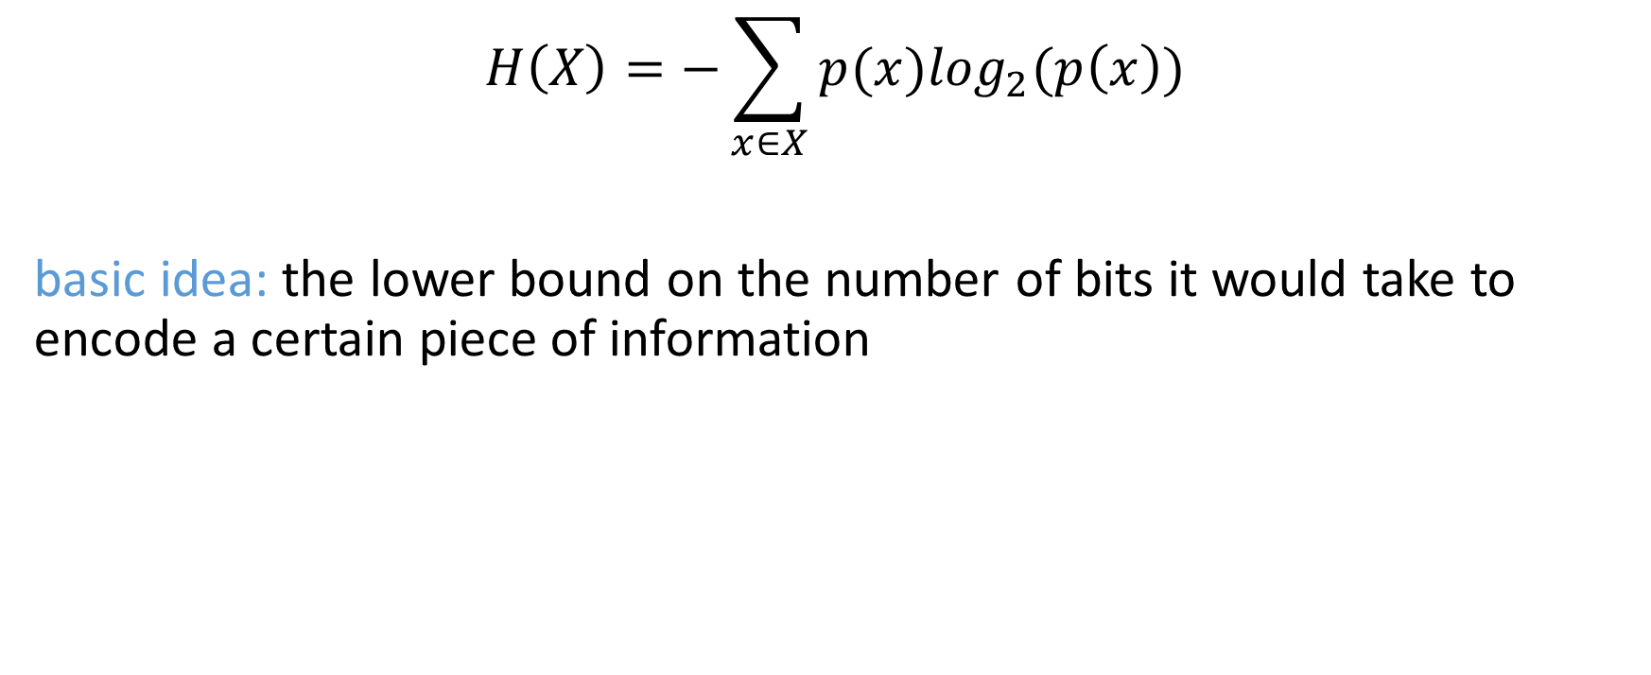
What is Entropy
$$H\left(X\right)=−\sum_{x∈X}{p(x)\log_{2}(p\left(x\right))}$$
basic idea: the lower bound on the number of bits it would take to encode a certain piece of information

Slide 41
What is Bayes Theorem (aka Bayes Rule)?

Slide 42

What is Bayes Theorem (aka Bayes Rule)?
$$P\left(X | Y\right)= \frac{P\left(Y | X\right)∗P(X)}{P(Y)}$$

Slide 43
Why would we use Bayes Rule?
$$P\left(X | Y\right)= \frac{P\left(Y | X\right)∗P(X)}{P(Y)}$$

Slide 44
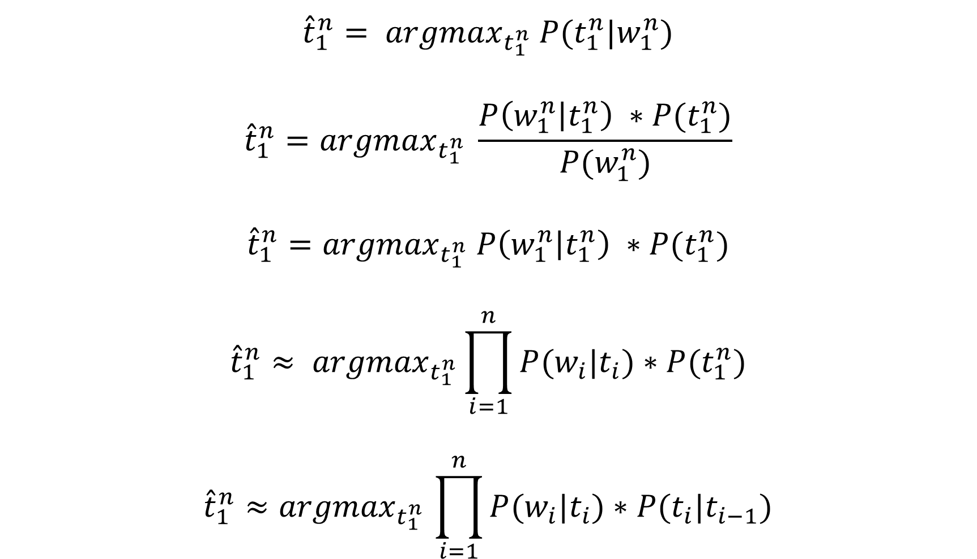
Using:
Bayes Rule
Independence Assumption
Markov Assumption
We could break the probability
into components and estimate
the overall probability of a tag
sequence.
$${\hat{t}}_{1}^{n}= {argmax}_{t_{1}^{n}} P(t_{1}^{n}|w_{1}^{n})$$
$${\hat{t}}_{1}^{n}={argmax}_{t_{1}^{n}} \frac{P\left(w_{1}^{n} | t_{1}^{n}\right) ∗P(t_{1}^{n})}{P(w_{1}^{n})}$$
$${\hat{t}}_{1}^{n}={argmax}_{t_{1}^{n}} P\left(w_{1}^{n} | t_{1}^{n}\right) ∗P(t_{1}^{n})$$
$${\hat{t}}_{1}^{n}≈ {argmax}_{t_{1}^{n}}\prod_{i=1}^{n}{P(w_{i}|t_{i})}∗P(t_{1}^{n})$$
$${\hat{t}}_{1}^{n}{≈argmax}_{t_{1}^{n}}\prod_{i=1}^{n}{P(w_{i}|t_{i})}∗P(t_{i}|t_{i−1})$$

Slide 45
Using:
Bayes Rule
Independence Assumption
Markov Assumption
We could break the probability
into components and estimate
the overall probability of a tag
sequence.
$${\hat{t}}_{1}^{n}= {argmax}_{t_{1}^{n}} P(t_{1}^{n}|w_{1}^{n})$$
$${\hat{t}}_{1}^{n}={argmax}_{t_{1}^{n}} \frac{P\left(w_{1}^{n} | t_{1}^{n}\right) ∗P(t_{1}^{n})}{P(w_{1}^{n})}$$
$${\hat{t}}_{1}^{n}={argmax}_{t_{1}^{n}} P\left(w_{1}^{n} | t_{1}^{n}\right) ∗P(t_{1}^{n})$$
$${\hat{t}}_{1}^{n}≈ {argmax}_{t_{1}^{n}}\prod_{i=1}^{n}{P(w_{i}|t_{i})}∗P(t_{1}^{n})$$
$${\hat{t}}_{1}^{n}{≈argmax}_{t_{1}^{n}}\prod_{i=1}^{n}{P(w_{i}|t_{i})}∗P(t_{i}|t_{i−1})$$
Bayes Rule

Slide 46
Using:
Bayes Rule
Independence Assumption
Markov Assumption
We could break the probability
into components and estimate
the overall probability of a tag
sequence.
$${\hat{t}}_{1}^{n}= {argmax}_{t_{1}^{n}} P(t_{1}^{n}|w_{1}^{n})$$
$${\hat{t}}_{1}^{n}={argmax}_{t_{1}^{n}} \frac{P\left(w_{1}^{n} | t_{1}^{n}\right) ∗P(t_{1}^{n})}{P(w_{1}^{n})}$$
$${\hat{t}}_{1}^{n}={argmax}_{t_{1}^{n}} P\left(w_{1}^{n} | t_{1}^{n}\right) ∗P(t_{1}^{n})$$
$${\hat{t}}_{1}^{n}≈ {argmax}_{t_{1}^{n}}\prod_{i=1}^{n}{P(w_{i}|t_{i})}∗P(t_{1}^{n})$$
$${\hat{t}}_{1}^{n}{≈argmax}_{t_{1}^{n}}\prod_{i=1}^{n}{P(w_{i}|t_{i})}∗P(t_{i}|t_{i−1})$$
Bayes Rule
Removed denominator
because same over all
calculations – doesn’t
change the outcome

Slide 47
Using:
Bayes Rule
Independence Assumption
Markov Assumption
We could break the probability
into components and estimate
the overall probability of a tag
sequence.
$${\hat{t}}_{1}^{n}= {argmax}_{t_{1}^{n}} P(t_{1}^{n}|w_{1}^{n})$$
$${\hat{t}}_{1}^{n}={argmax}_{t_{1}^{n}} \frac{P\left(w_{1}^{n} | t_{1}^{n}\right) ∗P(t_{1}^{n})}{P(w_{1}^{n})}$$
$${\hat{t}}_{1}^{n}={argmax}_{t_{1}^{n}} P\left(w_{1}^{n} | t_{1}^{n}\right) ∗P(t_{1}^{n})$$
$${\hat{t}}_{1}^{n}≈ {argmax}_{t_{1}^{n}}\prod_{i=1}^{n}{P(w_{i}|t_{i})}∗P(t_{1}^{n})$$
$${\hat{t}}_{1}^{n}{≈argmax}_{t_{1}^{n}}\prod_{i=1}^{n}{P(w_{i}|t_{i})}∗P(t_{i}|t_{i−1})$$
Bayes Rule
Removed denominator
because same over all
calculations – doesn’t
change the outcome
Assumption 1:
words are independent
of their tags

Slide 48
Using:
Bayes Rule
Independence Assumption
Markov Assumption
We could break the probability
into components and estimate
the overall probability of a tag
sequence.
$${\hat{t}}_{1}^{n}= {argmax}_{t_{1}^{n}} P(t_{1}^{n}|w_{1}^{n})$$
$${\hat{t}}_{1}^{n}={argmax}_{t_{1}^{n}} \frac{P\left(w_{1}^{n} | t_{1}^{n}\right) ∗P(t_{1}^{n})}{P(w_{1}^{n})}$$
$${\hat{t}}_{1}^{n}={argmax}_{t_{1}^{n}} P\left(w_{1}^{n} | t_{1}^{n}\right) ∗P(t_{1}^{n})$$
$${\hat{t}}_{1}^{n}≈ {argmax}_{t_{1}^{n}}\prod_{i=1}^{n}{P(w_{i}|t_{i})}∗P(t_{1}^{n})$$
$${\hat{t}}_{1}^{n}{≈argmax}_{t_{1}^{n}}\prod_{i=1}^{n}{P(w_{i}|t_{i})}∗P(t_{i}|t_{i−1})$$
Bayes Rule
Removed denominator
because same over all
calculations – doesn’t
change the outcome
Assumption 1:
words are independent
of their tags
Assumption 2:
Markov assumption
Bigram Model

Slide 49
What is the formula to calculate the most probable tag sequence?

Slide 50
Using the frequency tables which is the most probable tag?

Slide 51
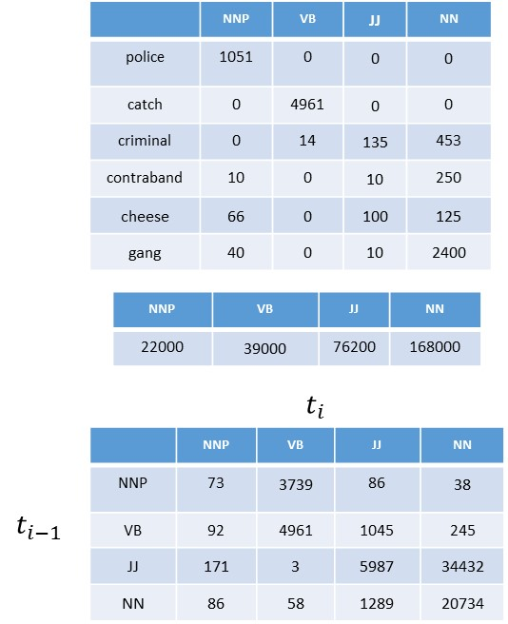
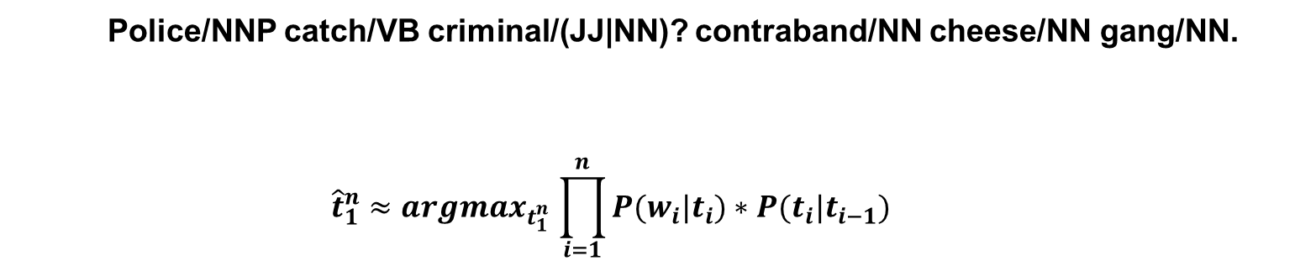
Police/NNP catch/VB criminal/(JJ|NN)? contraband/NN cheese/NN gang/NN.
$${\hat{t}}_{1}^{n}{≈argmax}_{t_{1}^{n}}\prod_{i=1}^{n}{P(w_{i}|t_{i})}∗P(t_{i}|t_{i−1})$$

Slide 52
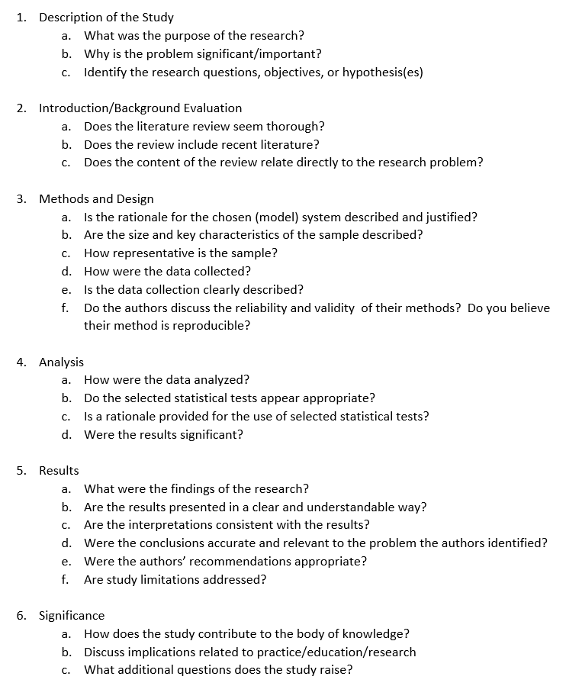
Questions will also include
Lecture:
Introduction
Regular Expressions
FSA & Formal Languages
Ngrams
Smoothing
Ngram statistics
Information Theory
Entropy
POS Tagging
Programming Assignment 1 & 2
News articles
Video Lecture
Wilk’s companionable agents
Papers
Turing’s Intelligent Machines
Lancashire & Hirst’s Agatha Christie
Turney’s Thumbs Up Thumbs Down
Twitter POS Tagging

